Slide 1
Session 32 : Android External Resources
Module 4.3 : Android

Slide 2
Learning Objectives
At the end of the session successful participants will be able to
Understand Resources and Internationalization
Use Resource types
Write Java Statements for Using Resources
Use Embedded Resources (drawable, string, array).

Slide 3
Android External Resources
Android Resources
Resources and Internationalization
Resources are external files (that is, non‐code files) that are used by your code and compiled into your application at build time.

Slide 4
Android External Resources
Android Resources
Resources and Internationalization
Android supports a number of different kinds of resource files, including XML, PNG, and JPEG files.
Resources are externalized from source code, and XML files are compiled into a binary fast loading format for efficiency reasons. Strings, likewise, are compressed into a more efficient storage form.

Slide 5
Android External Resources
Android Resources
Using Resources
The Android resource system keeps track y p of all non‐code assets associated with an application.
You use the Resources class to access your application's resources; the Resources instance associated with your application can generally be found through Context.getResources().
To use a resource, you must install it correctly in the source tree and build your application.

Slide 6
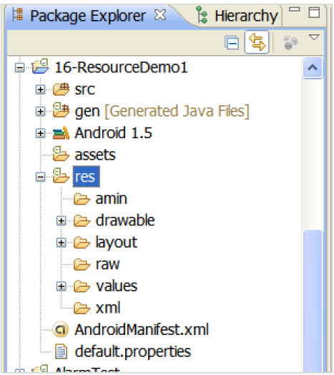
Android External Resources
Android Resources
Copy/Paste Resources
You will create and store your resource files under the appropriate subdirectory under the res/ directory in your project.

Slide 7
Android External Resources
Android Resources
Copy/Paste Resources
Resources are compiled into the final APK file.
Android creates a wrapper class, called R, that you can use to refer to these resources in your code. R contains subclasses named according to the path and file name of the source file

Slide 8
Android External Resources
Android Resources
Directory | Resource Types
res/anim/ | XML files that are compiled into frame by frame animation or tweened animation objects
res/drawable/ | .png, .9.png, .jpg files. To get a resource of this type, use mContext.getResources().getDrawable(R.drawable.imageId)
res/layout/ | XML files that are compiled into screen layouts (or part of a screen).
Cont…

Slide 9
Android External Resources
Android Resources
Directory | Resource Types
res/values/ | XML files that can be compiled into many kinds of resource. arrays.xml to define arrays colors.xml to define color drawables and color string values. Use Resources.getDrawable() and Resources.getColor(), respectively, to get these resources. dimens.xml to define dimension value. Use Resources.getDimension() to get these resources. strings.xml to define string values (use either Resources.getString or preferably Resources.getText() to get these resources. getText() will retain any rich text styling which is usually desirable for UI strings.styles.xml to define style objects.
Cont…

Slide 10
Android External Resources
Android Resources
Directory | Resource Types
res/xml/ | Arbitrary XML files that are compiled and can be read at run time by calling Resources.getXML().
res/raw/ | Arbitrary files to copy directly to the device. They are added uncompiled to the compressed file that your application build produces. To use these resources in your application, call Resources.openRawResource() with the resource ID, which is R.raw.somefilename

Slide 11
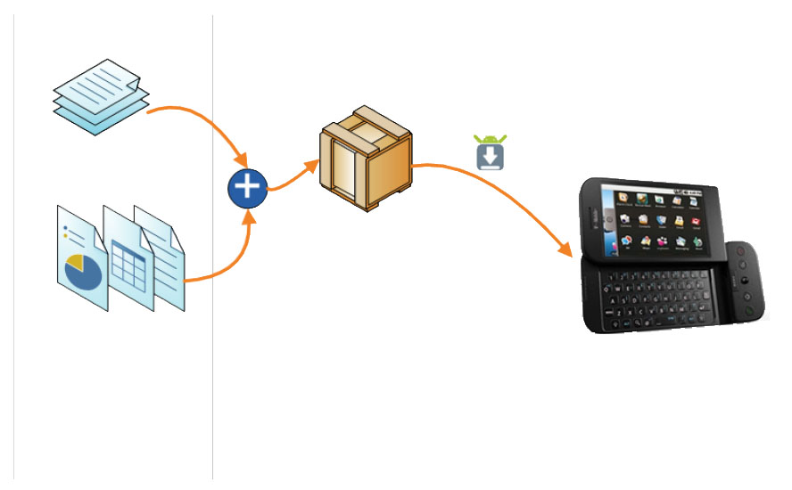
Android External Resources
Android Resources
Android Application
Java Code
Resources
res/anim
res/drawable
res/layout
res/values
res/raw
res/xml
A Typical Android Application consists of Java code and additional resources merged together into a deployable .apk file

Slide 12
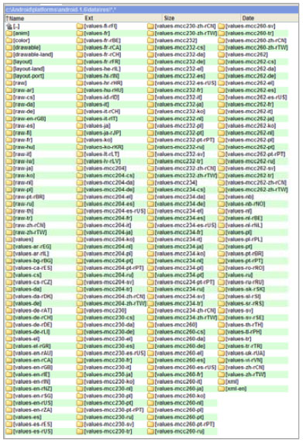
Android External Resources
Android Resources
Example: To see a number of samples you should explore the folder:
c:\Android\platforms\android‐1.5\data\res\

Slide 13
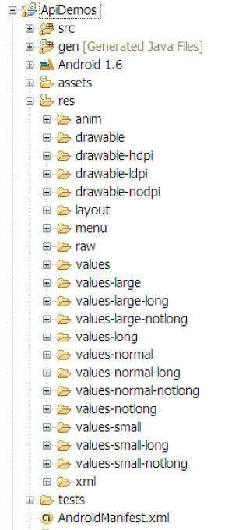
Android External Resources
Android Resources
Example: Try to install the ApiDemos
application. Explore its resource
folder. Find the source code in the
folder:
c:\Android\platforms\android‐1.6\samples\
How to install the App?
File ‐> New ‐> Project ‐> Android Project ‐> Next
Select "Create project form existing source“ Select the ApiDemos folder (all remaining fields will be self adjusted)

Slide 14
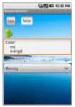
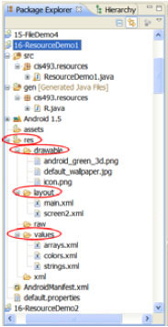
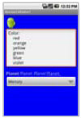
Android External Resources
Android Resources
Java Statements for Using Resources: Displaying a screen layout:
setContentView(R.layout.main);
setContentView(R.layout.screen2);

Slide 15
Android External Resources
Android Resources
Java Statements for Using Resources: Retrieving String Resources from: res/values/…
/res/values/strings.xml
<?xml version="1.0" encoding="utf-8"?> <resources>
<string name="hello">Hola Mundo!, ResourceDemo1!</string>
<string name="app_name">ResourceDemo1</string>
<string name="good_bye">Hasta luego</string>
<string name="color_caption">Color:</string>
<string name="color_prompt">Seleccione un Color</string><string name="planet_caption"> <b>Planeta </b>Planeta <i>Planeta </i><u>Planeta:
</u></string><string name="planet_prompt"> Seleccione un Planeta </string> </resources>
String msg =this.getString(R.string.color_prompt);

Slide 16
Android External Resources
Android Resources
Java Statements for Using Resources:
Enhancing externalized String resources from: res/values/…
/res/values/strings.xml
<?xml version="1.0" encoding="utf-8"?>
<resources>
<string name="hello">Hola Mundo!, ResourceDemo1!</string>
<string name="app_name">ResourceDemo1</string>
<string name="good_bye">Hasta luego</string>
<string name="color_caption">Color:</string>
<string name="color_prompt">Seleccione un Color</string>
<string name="planet_caption">
<b>Planeta </b>Planeta <i>Planeta </i><u>Planeta: </u></string>
<string name="planet_prompt">Seleccione un Planeta</string>
</resources>

Slide 17
Android External Resources
Android Resources
Java Statements for Using Resources:
Enhancing externalized String resources from: res/values/…
As in HTML a string using <b>, <i>, <u> modifiers will be rendered in: bold, italics, and, underlined modes. In our example: Planeta Planeta Planeta Planeta

Slide 18
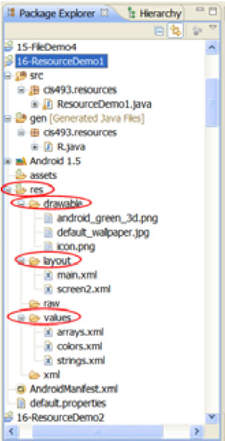
Android External Resources
Android Resources
Java Statements for Using Resources:
Retrieving Array Resources from: res/values/…

Slide 19
Android External Resources
Android Resources
Java Statements for Using Resources:
Retrieving Array Resources from: res/values/…
/res/values/strings.xml
<?xml version="1.0" encoding="utf-8"?>
<resources>
<string-array name="colors">
<item>red</item>
<item>orange</item>
<item>yellow</item>
<item>green</item>
<item>blue</item>
<item>violet</item>
</string-array>
<string-array name="planets">
<item>Mercury</item>
<item>Venus</item>
<item>Earth</item><item>Mars</item>
<item>Jupiter</item>
<item>Saturn</item>
<item>Uranus</item>
<item>Neptune</item>
<item>Pluto</item>
</string-array>
/res/values/arrays.xml
</resources>

Slide 20
Android External Resources
Android Resources
Java Statements for Using Resources:
Retrieving Array Resources from: res/values/…
/res/values/strings.xml
<?xml version="1.0" encoding="utf-8"?>
<resources>
<string-array name="colors">
<item>red</item>
<item>orange</item>
<item>yellow</item>
<item>green</item>
<item>blue</item>
<item>violet</item>
</string-array>
<string-array name="planets">
<item>Mercury</item>
<item>Venus</item>
<item>Earth</item><item>Mars</item>
<item>Jupiter</item>
<item>Saturn</item>
<item>Uranus</item>
<item>Neptune</item>
<item>Pluto</item>
</string-array>
/res/values/arrays.xml
</resources>
String msg =this.getString(R.string.color_prompt);

Slide 21
Android External Resources
Android Resources
Java Statements for Using Resources:
Retrieving a drawable image from: res/drawable/…
//same as xml layout attribute
//android:src="@drawable/android_green_3d“
imageView1.setImageResource(R.drawable.android_green_3d);

Slide 22
Android External Resources
Android Resources
Example 1: Using Embedded Resources (drawable, string, array).
<?xml version="1.0" encoding="utf-8"?>
<LinearLayout
xmlns:android="http://schemas.android.com/apk/res/an
droid"
android:orientation="vertical"
android:padding="10dip"
android:layout_width="fill_parent"
android:layout_height="fill_parent"
android:background="@color/solid_blue”>
/res/values/color.xml
<?xml version="1.0" encoding="utf-8"?>
<resources>
<drawable name="red">#7f00</drawable>
<drawable name="blue">#770000ff</drawable>
<drawable name="green">#7700ff00</drawable>
<color name="solid_red">#f00</color>
<color name="solid_blue">#0000ff</color>
<color name="solid_green">#f0f0</color>
<color name="solid_yellow">#ffffff00</color>
</resources>

Slide 23
Android External Resources
Android Resources
Example 1: Using Embedded Resources (drawable, string, array).
<ImageView
android:id="@+id/ImageView01"
android:layout_width="wrap_content"
android:layout_height="wrap_content"
>
</ImageView>
<EditText
android:id="@+id/txtColorBox"
android:layout_width="fill_parent"
android:layout_height="wrap_content"
/>

Slide 24
Android External Resources
Android Resources
Example 1: Using Embedded Resources (drawable, string, array).
<TextView
android:layout_width="fill_parent"
android:layout_height="wrap_content"
android:layout_marginTop="10dip"
android:textSize="18px"
android:text="@string/planet_caption“ />
<Spinner android:id="@+id/spinner2"
android:layout_width="fill_parent"
android:layout_height="wrap_content"
android:drawSelectorOnTop="true"
android:prompt="@string/planet_prompt”/>
</LinearLayout>

Slide 25
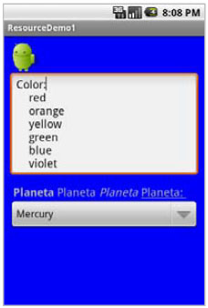
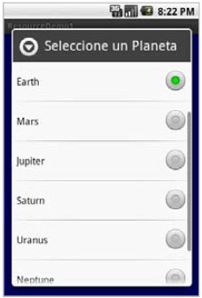
Android External Resources
Android Resources
Example 1: Using Embedded Resources (drawable, string, array).

Slide 26
Android External Resources
Android Resources
Example 1: Using Embedded Resources (drawable, string, array).
// using Resources (adapted from Android - ApiDemos)
package cis493.resources;
import android.app.Activity;
import android.os.Bundle;
import android.widget.ArrayAdapter;
import android.widget.EditText;
import android.widget.ImageView;
import android.widget.Spinner;
public class ResourceDemo1 extends Activity {
@Override
public void onCreate(Bundle savedInstanceState) {

Slide 27
Android External Resources
Android Resources
Example 1: Using Embedded Resources (drawable, string, array).
super.onCreate(savedInstanceState);
setContentView(R.layout.main);
//TRY: setContentView(R.layout.screen2);
ImageView imageView1 = (ImageView)findViewById(R.id.ImageView01);
//similar to xml layout android:src="@drawable/android_green_3d"
imageView1.setImageResource(R.drawable.android_green_3d);
EditText txtColorBox = (EditText)findViewById(R.id.txtColorBox);
String msg = this.getString(R.string.color_caption);
String myColors[] =

Slide 28
Android External Resources
Android Resources
Example 1: Using Embedded Resources (drawable, string, array).
this.getResources().getStringArray(R.array.colors);
for ( int i=0; i<myColors.length; i++){
msg += "\n\t" + myColors[i];
}
txtColorBox.setText(msg);
Spinner s2 = (Spinner) findViewById(R.id.spinner2);
ArrayAdapter<CharSequence> adapter = ArrayAdapter.createFromResource(
this,
R.array.planets,
android.R.layout.simple_spinner_item);
adapter.setDropDownViewResource(

Slide 29
Android External Resources
Android Resources
Example 1: Using Embedded Resources (drawable, string, array).
android.R.layout.simple_spinner_dropdown_item);
s2.setAdapter(adapter);
}
}

